Slide 1
Machine Learning: Cell Detection and Counting
Mahan Miryala, John Chinnamallela, Jacob Walker,
Lulia Berianu, Elizabeth Wolters

Slide 2
Project Overview
Goal: This project aims to develop an automated solution to detect and count cells in microscopy images
Several datasets were utilized to train the machine learning model:
Masaryk University Cell Image Collection(MUCIC)
Broad Bioimage Benchmark Collection(BBBC)
2018 Data Science Bowl
LIVECell
Accurate quantification of cells in biomedical images is essential for cancer diagnosis, drug development, and understanding cellular mechanisms

Slide 3
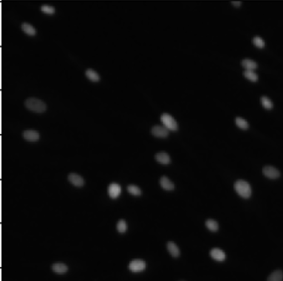
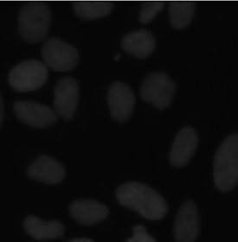
Problem
The need for a more efficient, scalable, and accurate approach to automate cell detection
Manual counting of cells in biomedical images is time-consuming
Errors due to observer bias:
Variability in cell shapes and sizes.
Presence of noise and low contrast in microscopy images.
Raw microscopy images of cells that must be detected and counted

Slide 4
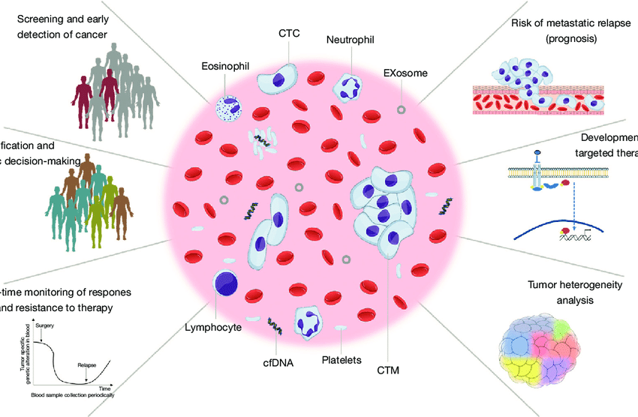
Significance
Automating cell detection will significantly reduce the time and effort required for cell quantification.
A robust solution can enhance the reproducibility and accuracy of research studies in biomedical fields.
The model can be applied to various research domains, improving data consistency and accelerating biomedical discoveries.
Available from: https://www.researchgate.net/figure/The-potential-clinical-benefits-of-CTC-and-ctDNA-analyses-in-cancer-care-CTC_fig1_309602089 [accessed 2 Dec 2024]

Slide 5
Data
Datasets:
contained annotated microscopy images from diverse cell types.
Images are paired with ground truth masks, showing the true cell locations in the images.
Data Characteristics:
Images are in PNG format, and the masks are also in PNG format, indicating cell locations.
The images are resized to a uniform size for processing.

Slide 6
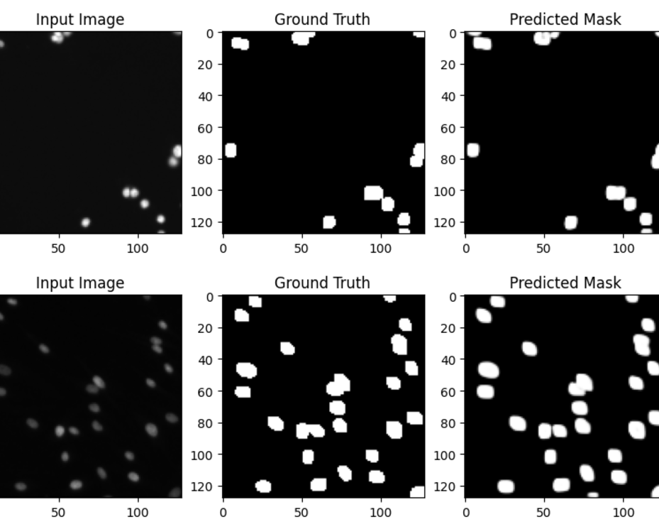
Methodology
Data Preprocessing:
Starts with loading images and labels, which are passed to the model in batches
Model:
U-Net architecture was used for image segmentation.
The model is trained to predict binary masks that highlight the nuclei of cells.
After training, we evaluate the model by comparing predictions against actual labels

Slide 7
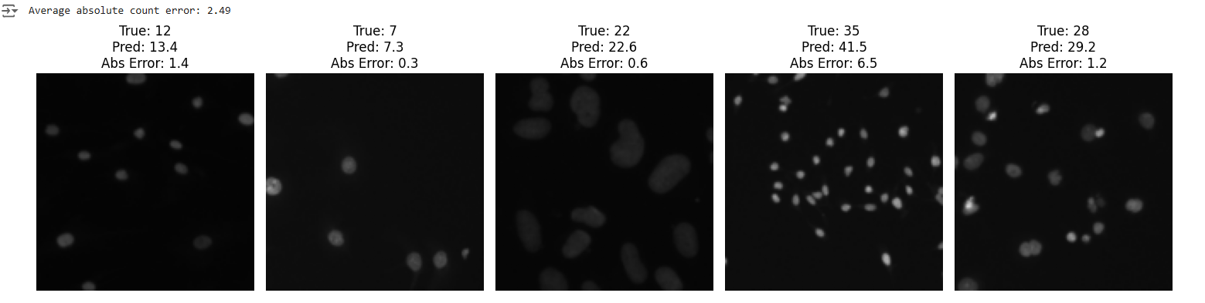
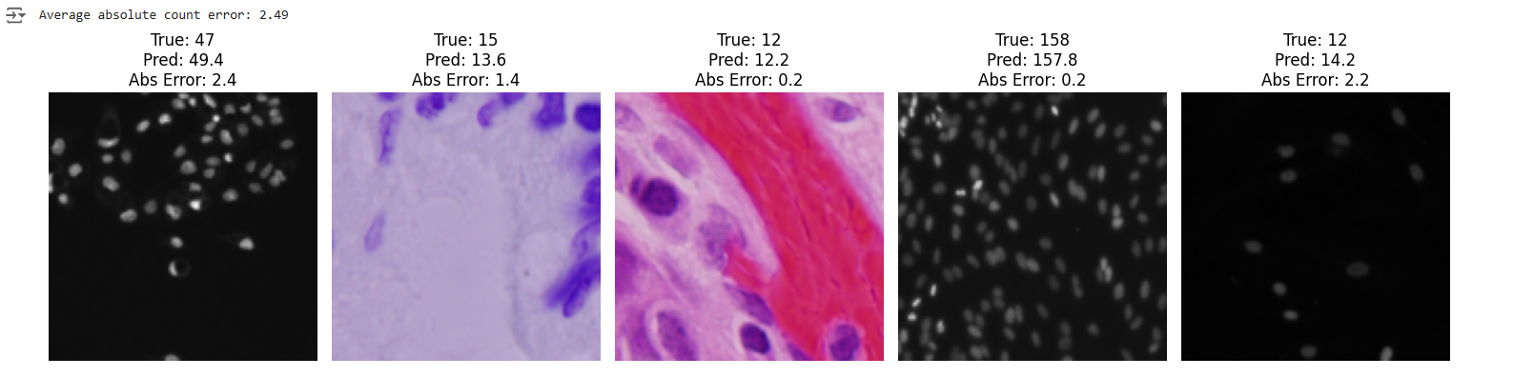
Results

